Slide 1
Hackathon Project
GROUP-4
(Brain In Jar)
(QEA21QE070) genc training

Slide 2
Team Members
Ayushi Jain - 2112026
Harsh Bartariya - 2112007
Shivang Prajapati - 2111856
Mukul Singh - 2111879
Anuj Kumar Yadav – 2111922
Hariom Shukla - 2112174

Slide 3
Project Title : Calculate Trip Cost
Display total amount and charges per night for 3 holiday homes and cruise details:-
1. For 4 people in Nairobi from 15th Dec-2019 to 20th Dec-2019 2. Sort the list with highest traveler rating on top. 3. Holiday home should have elevator/ List access. 4. Pick one cruise line & pick a respective cruise ship under Cruises:- a. Retrieve all the languages offered and store in a List;
Display the same b. Display passengers, crew & launched year
(Suggested Site: tripadvisor.in however you are free to choose any other legitimate site)

Slide 4
Website used:
https://www.tripadvisor.in/
Tools/Software's Used:
Selenium – Portable Framework for testing Web Applications and automating the process.
Java – High level Programming Language.
Eclipse – Integrated Development Environment for various ‘Languages’.
TestNG – Open source testing framework.
Maven – Software and project Management Tool.
POM – Object repository design pattern.
Jenkins – An open source automation server for continuous integration.
Selenium Grid – Tool use to distribute test to run test in parallel on multiple machine or browser.
GIT – A distributed version-control system for tracking changes in any set of files for better co-ordination.

Slide 5
Work Done
The code is written in JAVA language and then is further automated using Selenium.
Page Object Model(POM) is used to reduce the code duplication for various instances.
Data obtained from website is stored in Excel Sheet using Apache POI; also, data input is taken from a file with variables written in it.
Jenkins, Grid and GIT repositories are also used, so as to make it easy to make changes to various versions of code and to modularise it; also to help with continuous integration.

Slide 6
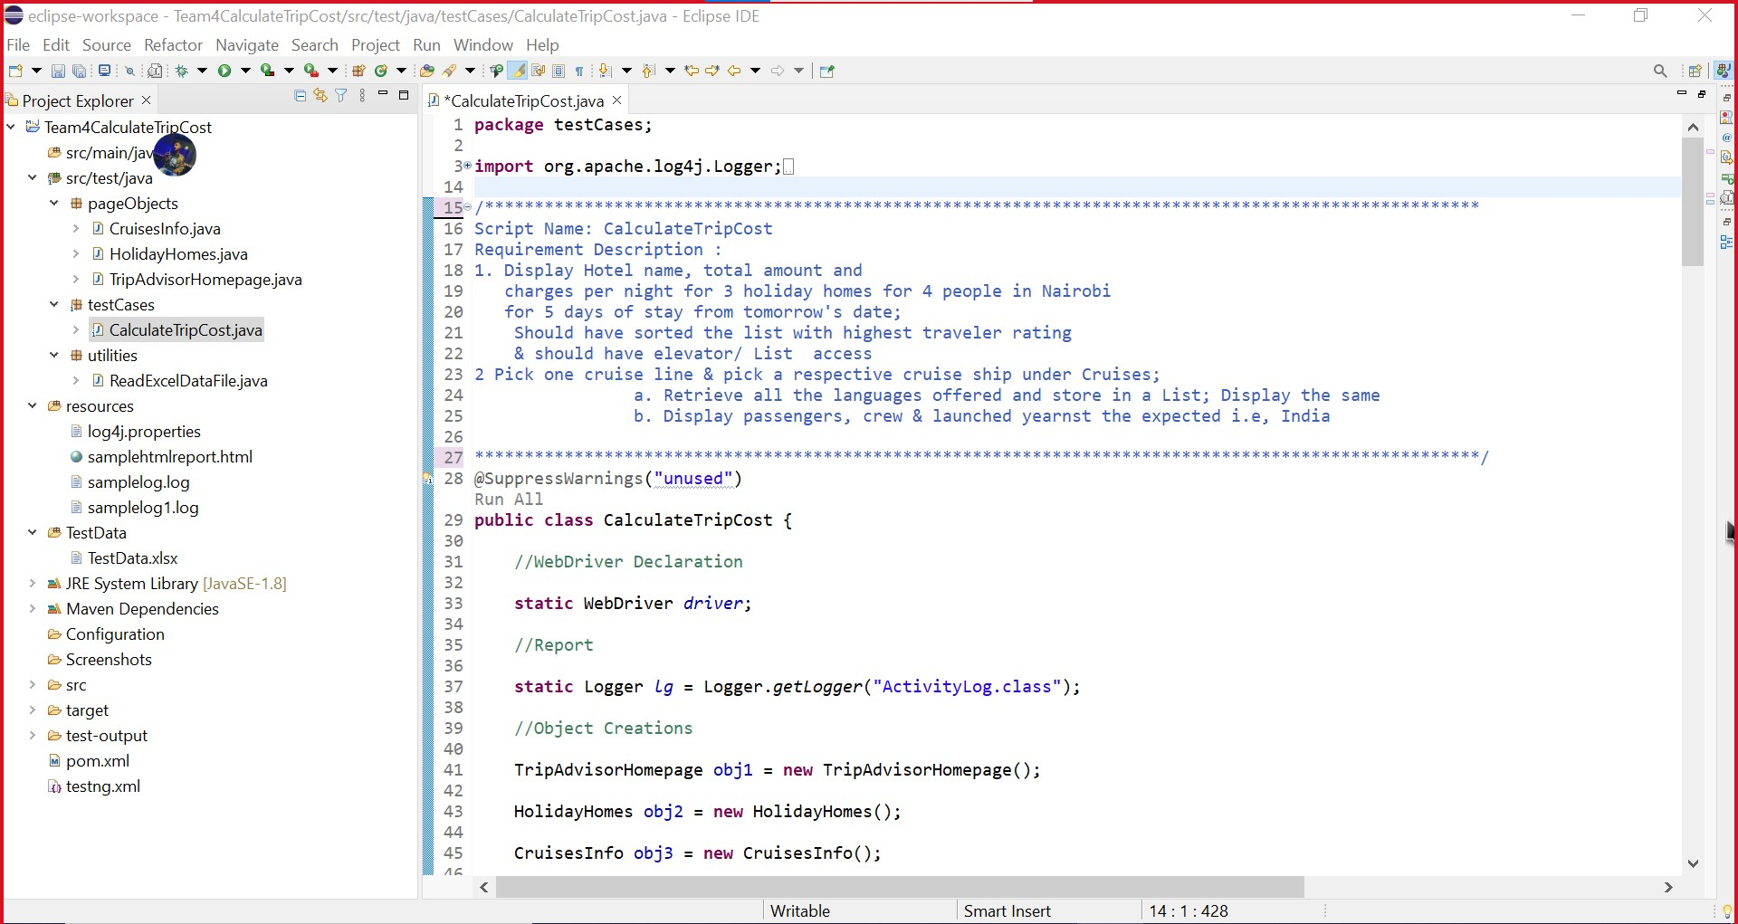
Project Structure

Slide 7
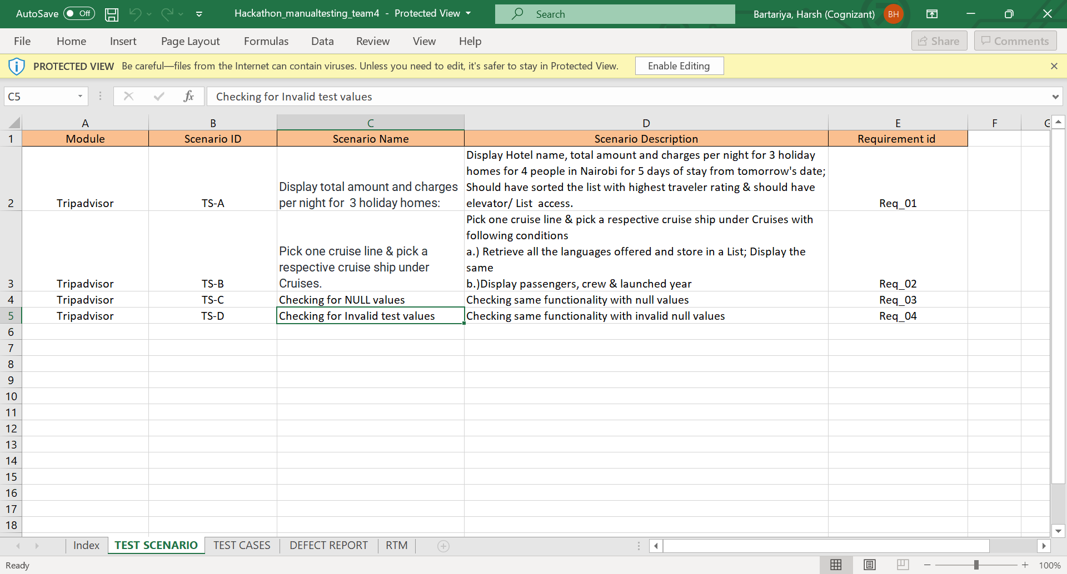
Test Scenario

Slide 8
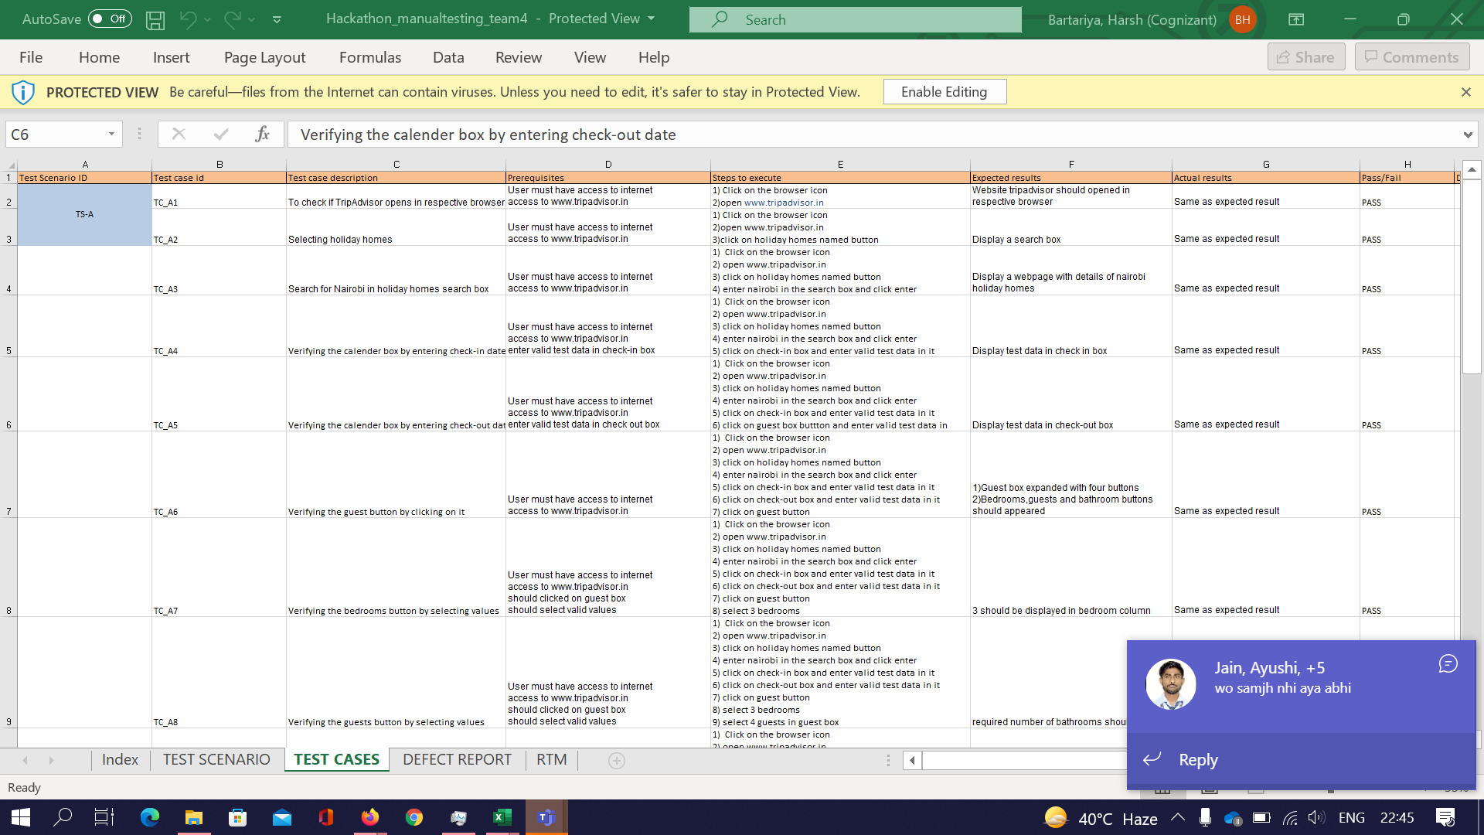
Test cases

Slide 9
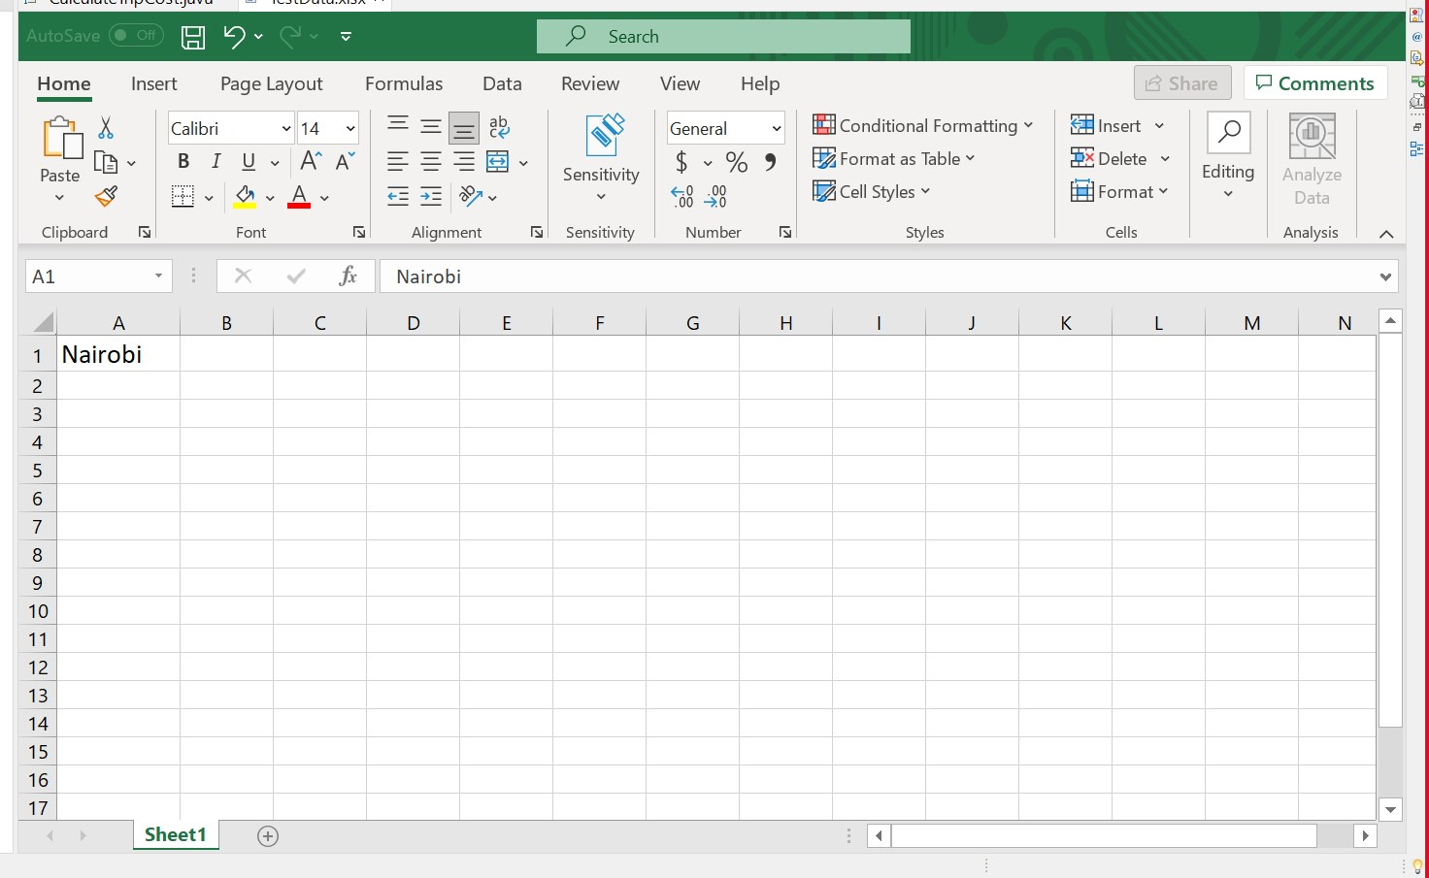
Input Excel File

Slide 10
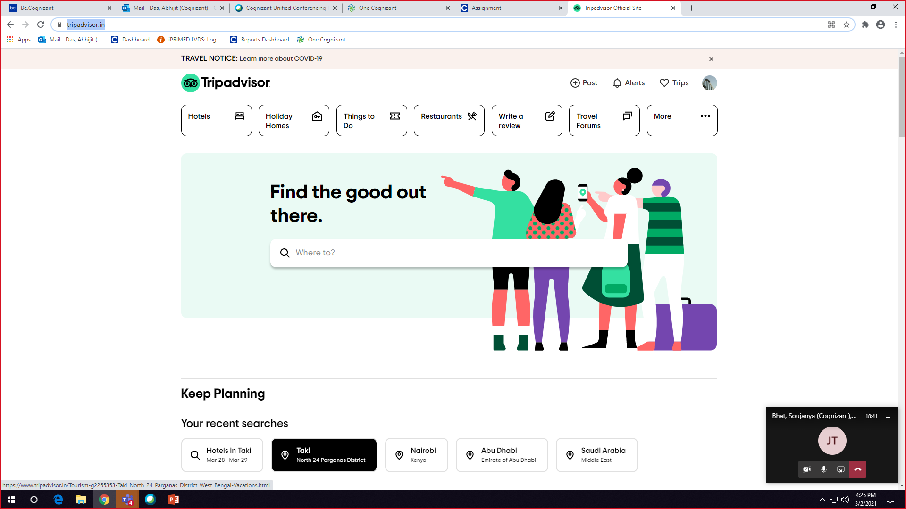
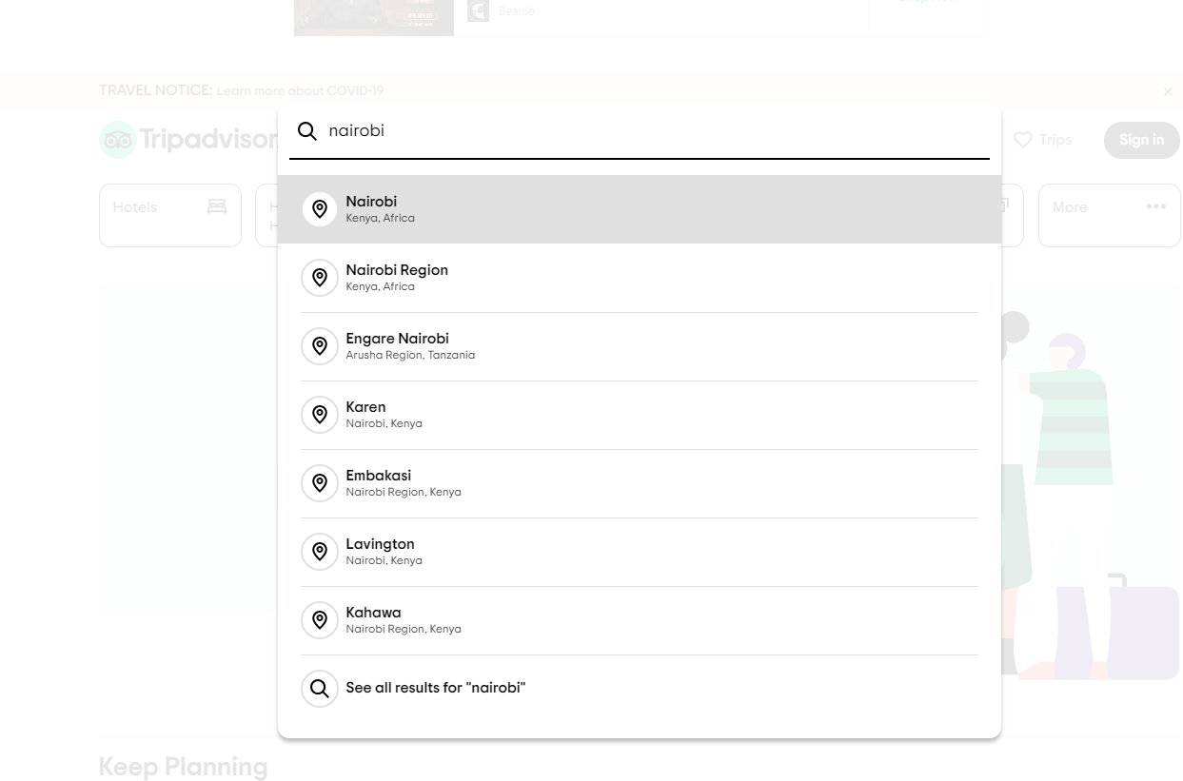
Real Time Screenshot

Slide 11
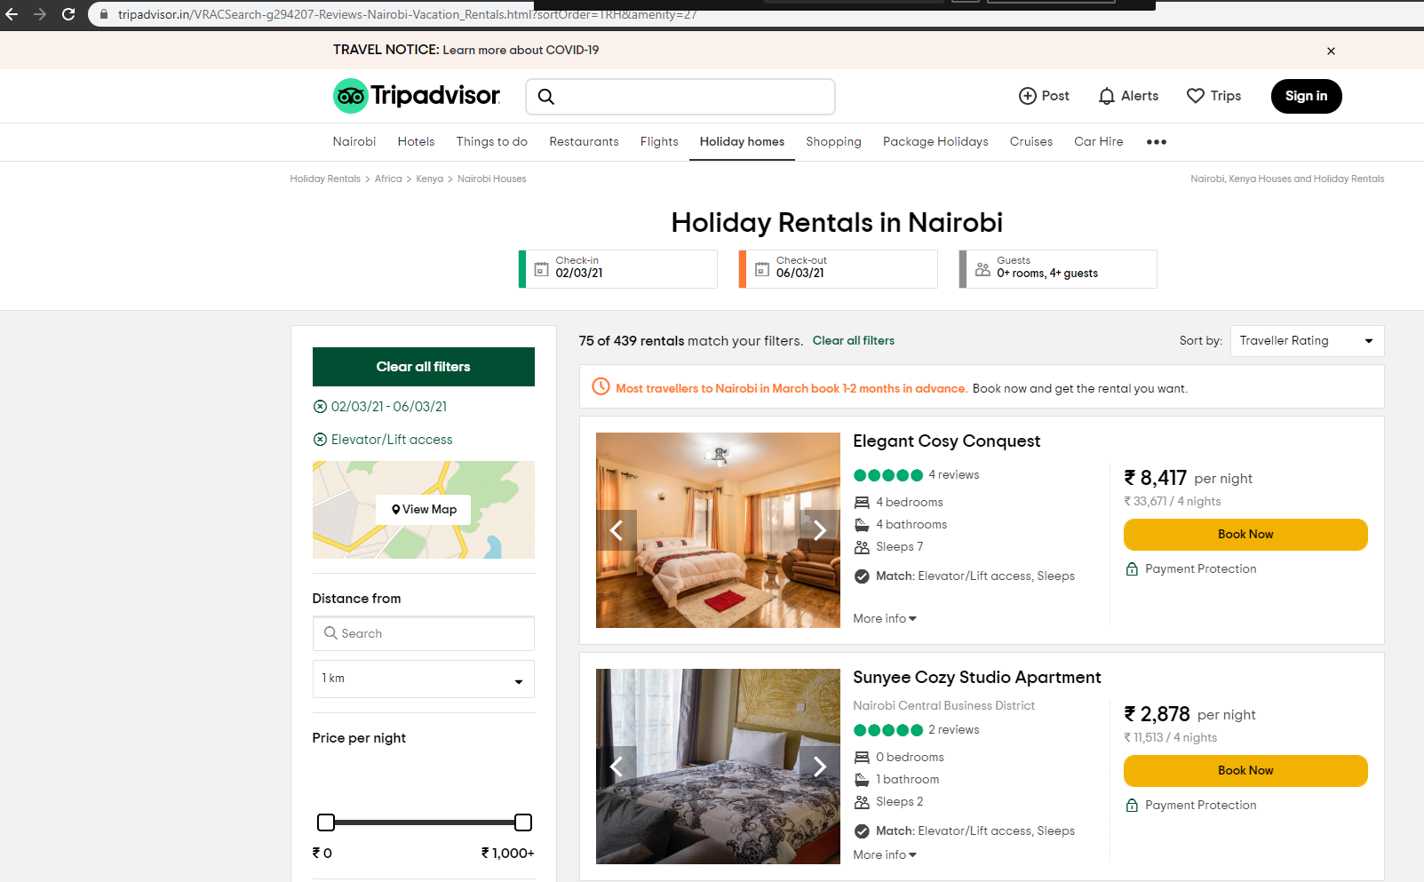
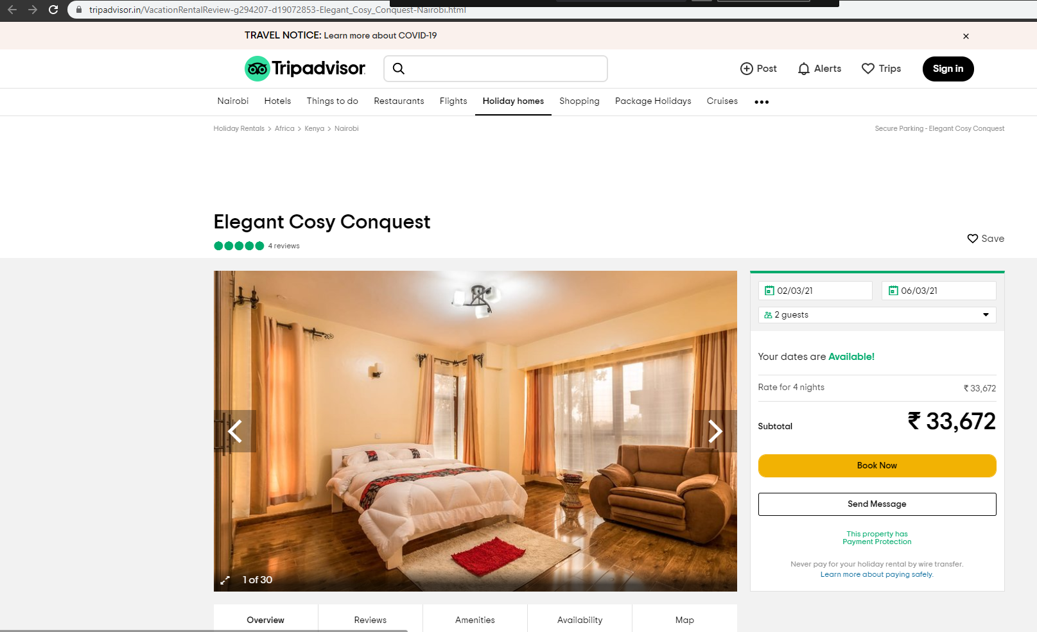
Real Time Screenshot

Slide 12
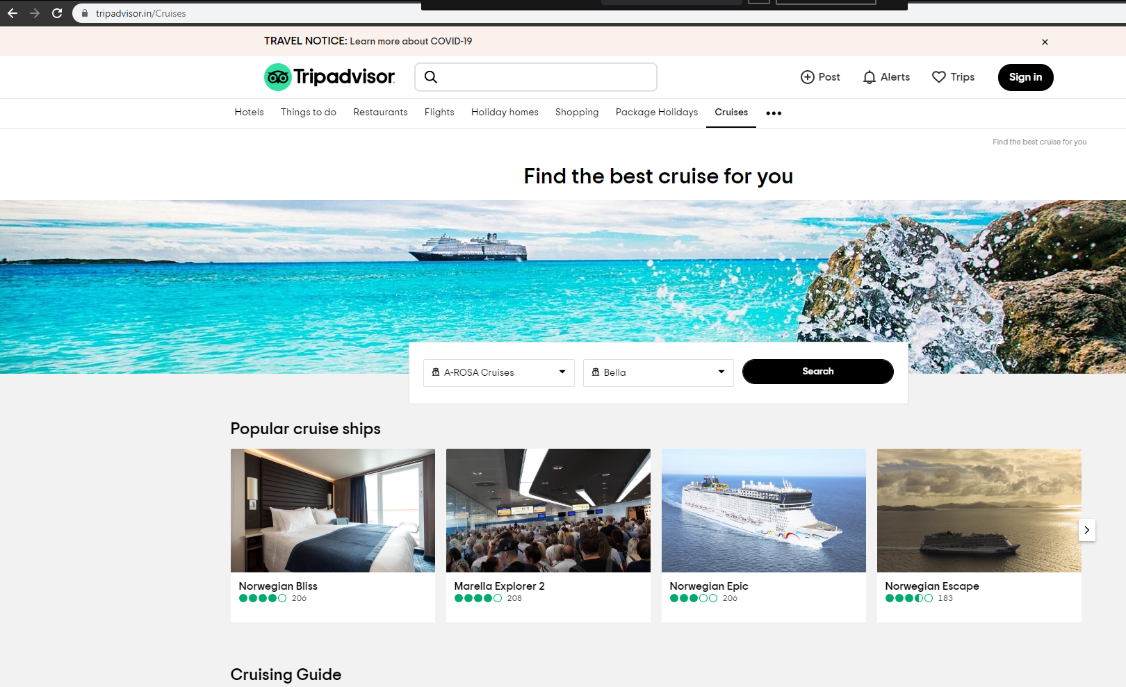
Real Time Screenshot

Slide 13
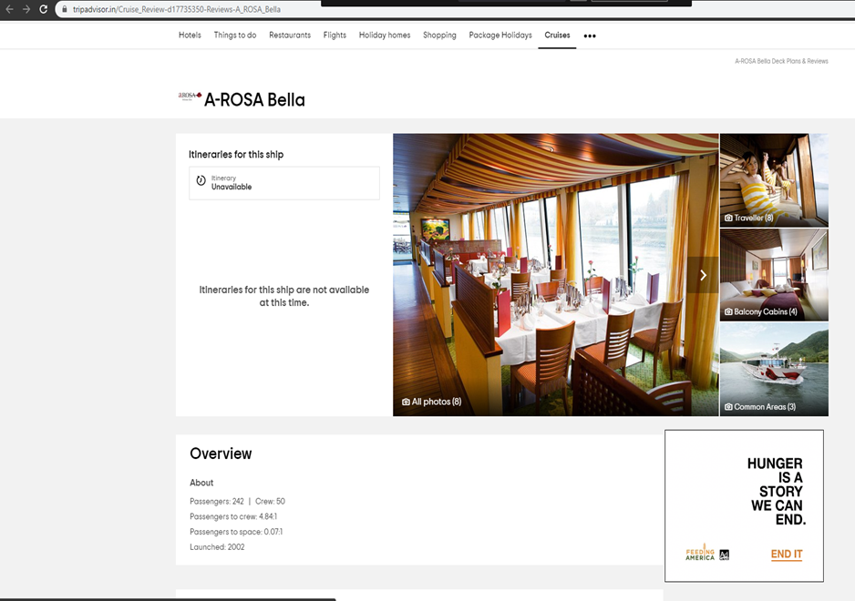
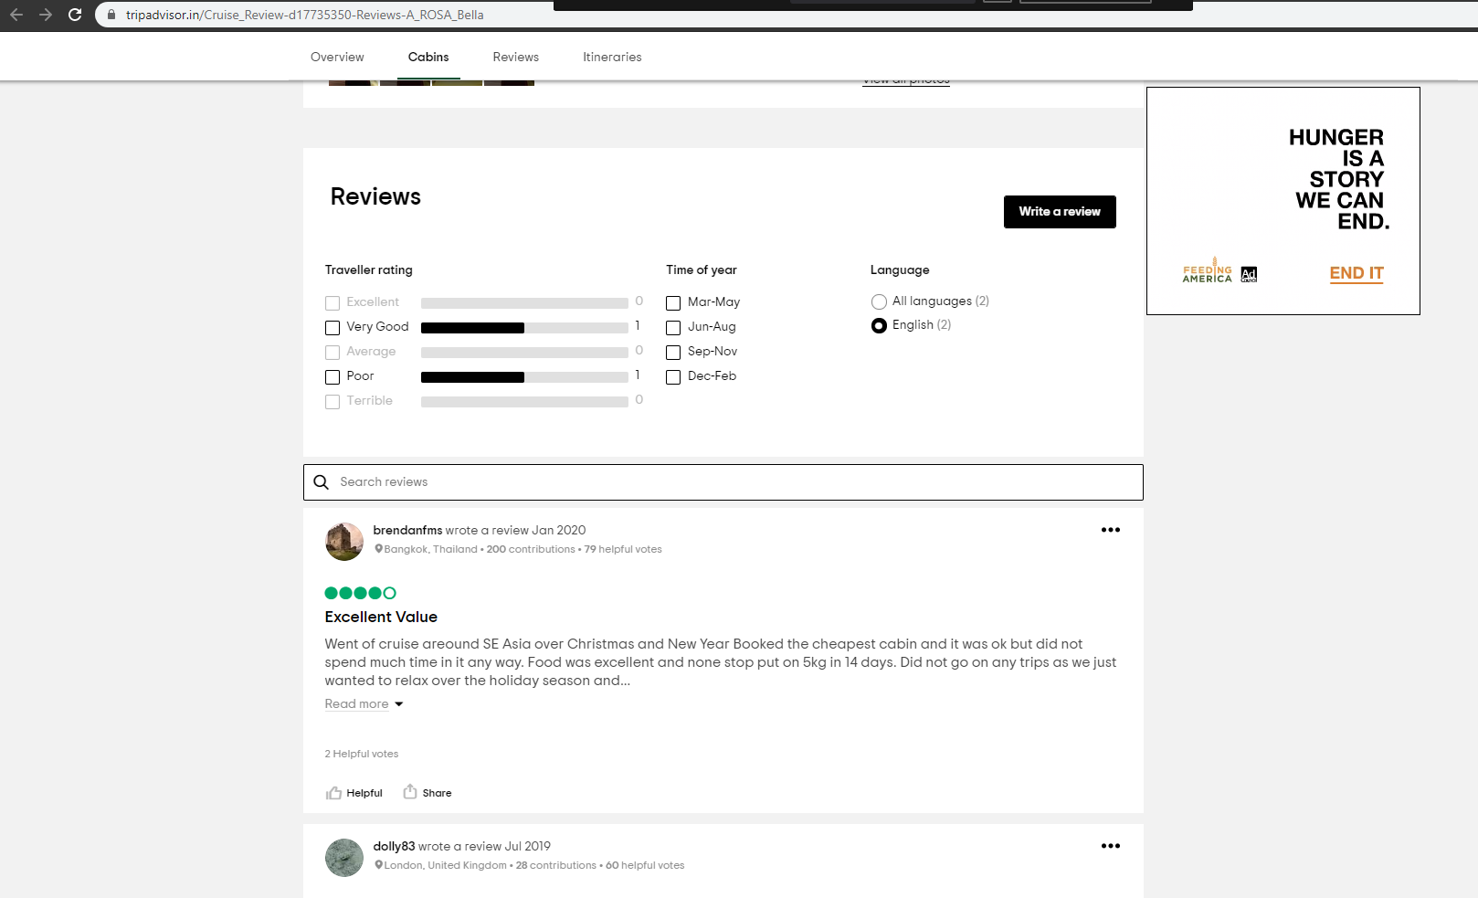
Real Time Screenshot

Slide 14
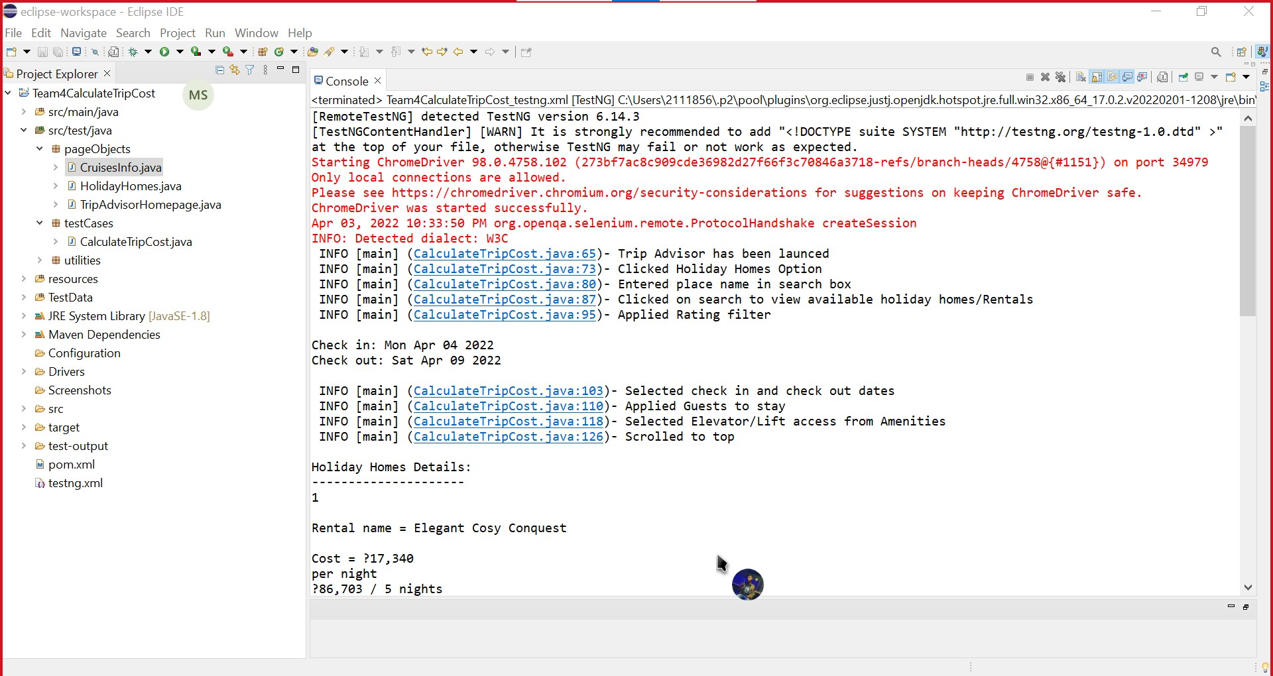
Saved Output Screenshot

Slide 15
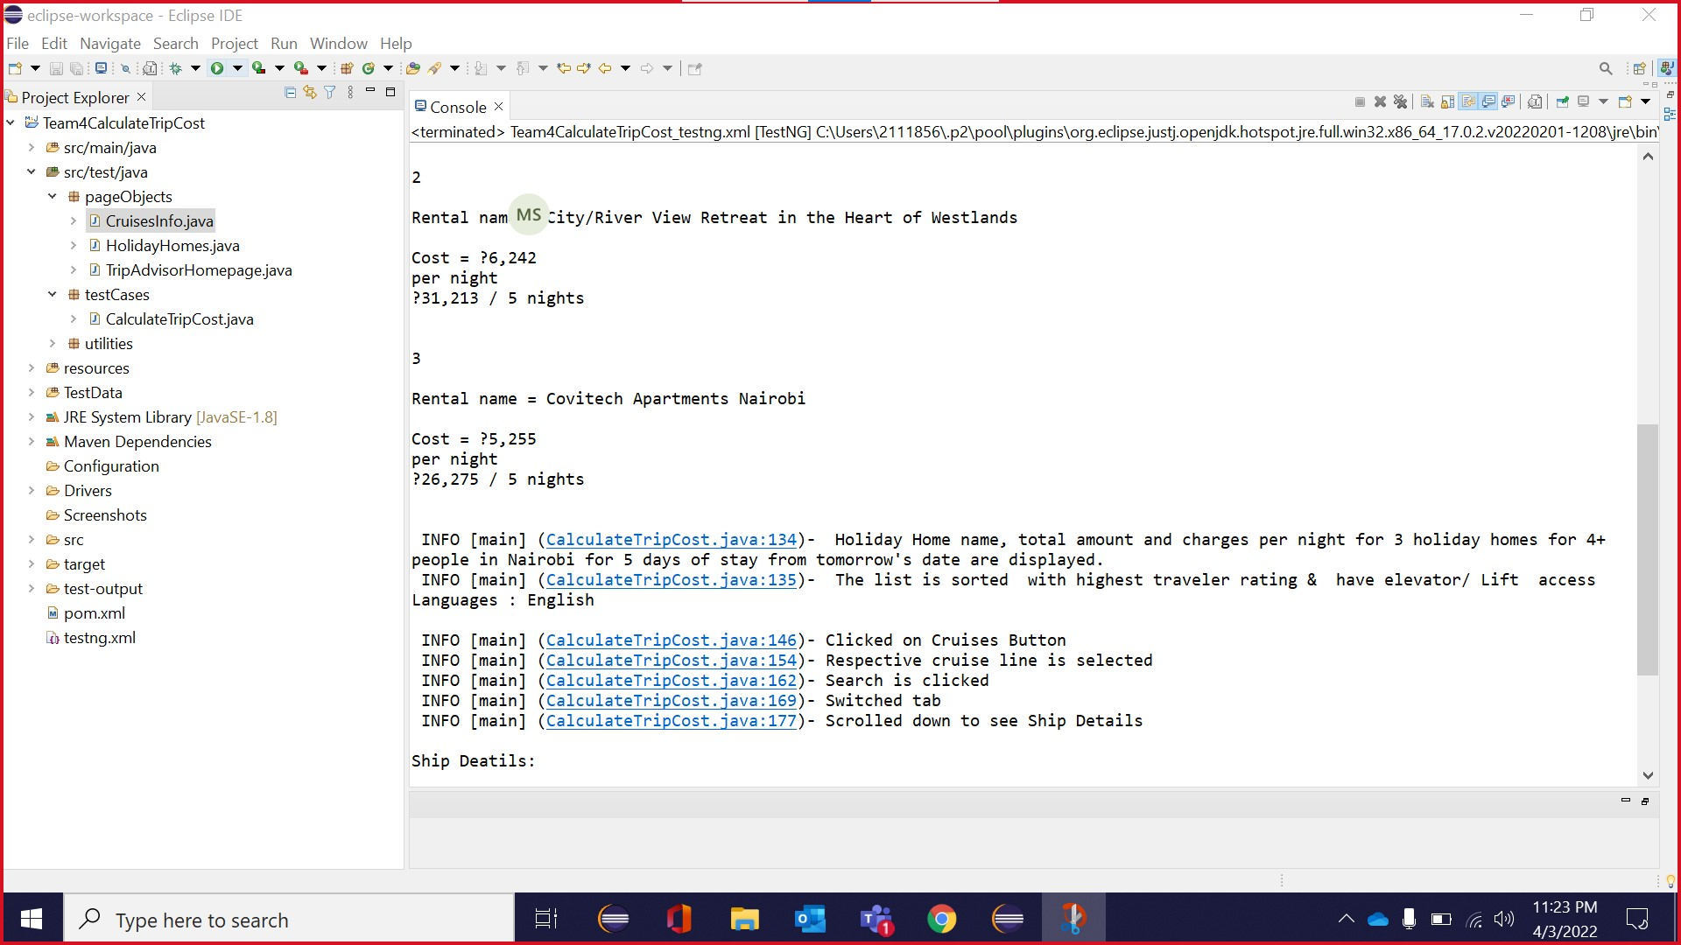
SAVED OUTPUT SCREENSHOT

Slide 16
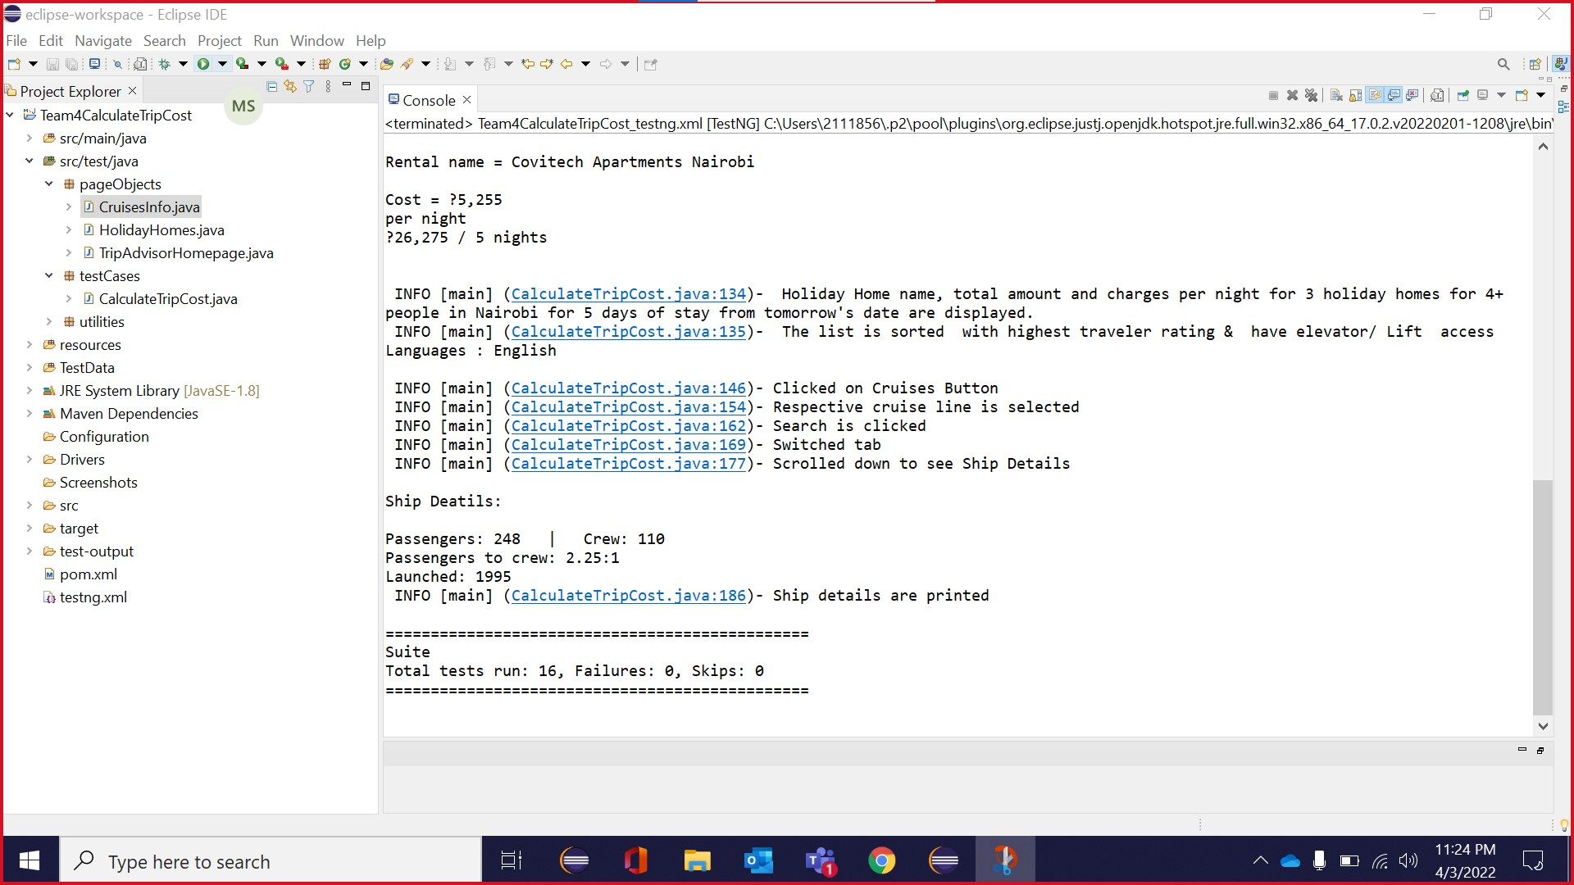
SAVED OUTPUT SCREENSHOT

Slide 17
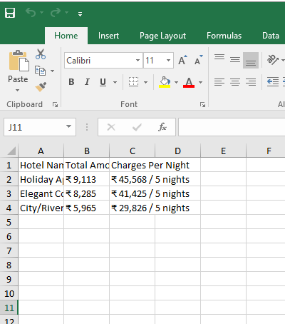
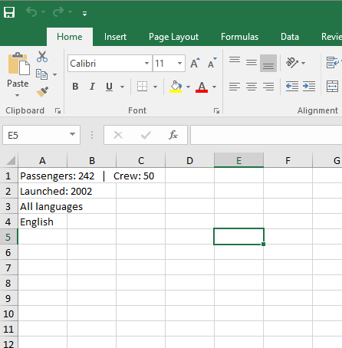
Saved Output Screenshot
EXCEL FILE

Slide 18

THANK YOU

